Slide 1

Predicting product demand
Elliot Blackstone
Amirhossein Tavakoli
Mentor: S. C. Park

Slide 2
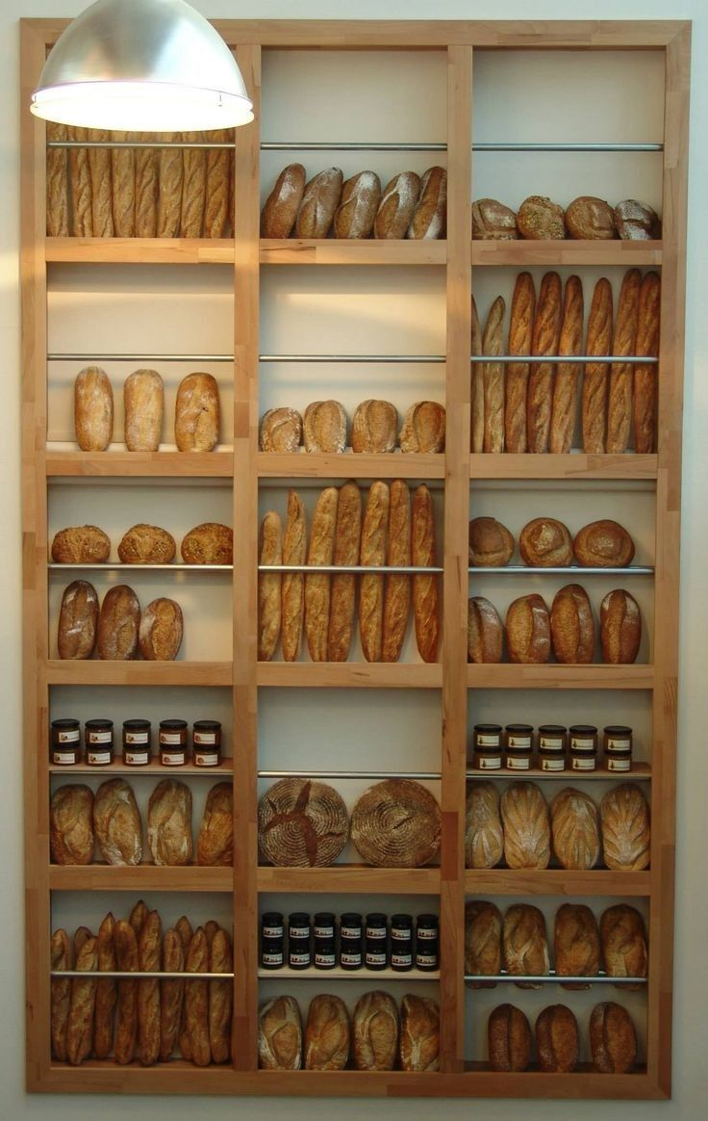
Motivation
Keeping track of inventory helps businesses stay ahead of the game.
High storage costs mean smart planning is a must.
For perishable goods, managing inventory can stop waste and shortages.
Matching supply with demand is crucial when things change fast.
Goal
Develop a predictive model to optimize firms’ inventory decision
Notes:
Inventory management is a universal challenge for businesses. With rising competition and expanding urban areas, inventory facilities have become increasingly expensive. Making smart inventory decisions is crucial—not just to remain competitive in the market but also to adapt to rapidly changing demands. This is especially important for companies dealing with perishable goods. These businesses must strike a careful balance between meeting demand and avoiding oversupply.
Our goal in this project is to develop a predictive model to optimize a firm’s inventory decision.

Slide 3

Grupo Bimbo predict product demand!
Delivers products to clients weekly
Delivers to over 1 million stores along 45,000 routes across Mexico
Our goal is to predict the firms’ adjusted demand (sales – returns)
Notes:
Grupo Bimbo is a large Mexican company that sells baked goods all over the world. In this project, we predict the demand for perishable baked goods in central Mexico. Clients receive products arriving along various routes each week from numerous sales depots. Any unsold goods at the end of the week are bought back at half price by Grupo Bimbo (i.e. returns). For each product each client purchases, the target variable is adjusted demand, which equals the number of sales minus the number of returns. Our training data contains past sales data on weeks 3 through 9. The goal is to predict the adjusted demand for many clients in weeks 10 and 11.

Slide 4
Data set features
Client ID
Product ID
Route ID
Sales Depot ID
Sold units and value
Returned units and value
Adjusted Demand
Town and State
Training data contains roughly 75 million observations for demand in weeks 3 to 9
Our goal is to predict the demand for weeks 10 and 11
Notes:
The training data set has roughly 75 million rows! In addition to week number and adjusted demand, each row contains 13 entries, such as week number, client ID, product ID, route ID, etc. Additional information provided is the client names, product names, and town/state locations. This dataset was collected from central Mexico.

Slide 5
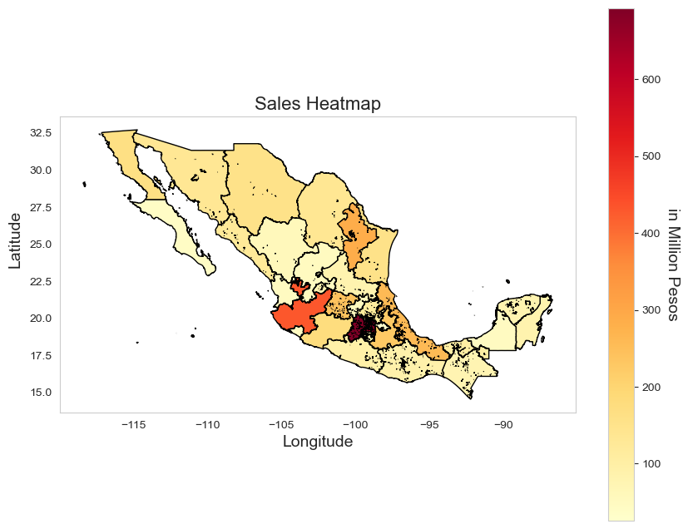
Demand Heatmap
Aggregated sales at the state level
Merged with GeoJSON
Significant heterogeneity in demand across states
Notes:
To understand demand variation across states, we aggregate sales at the state level and merge this data with an external Geographic JavaScript Object Notation. The heatmap shows regions like the State of Mexico, Jalisco, and Veracruz have the highest demand.

Slide 6
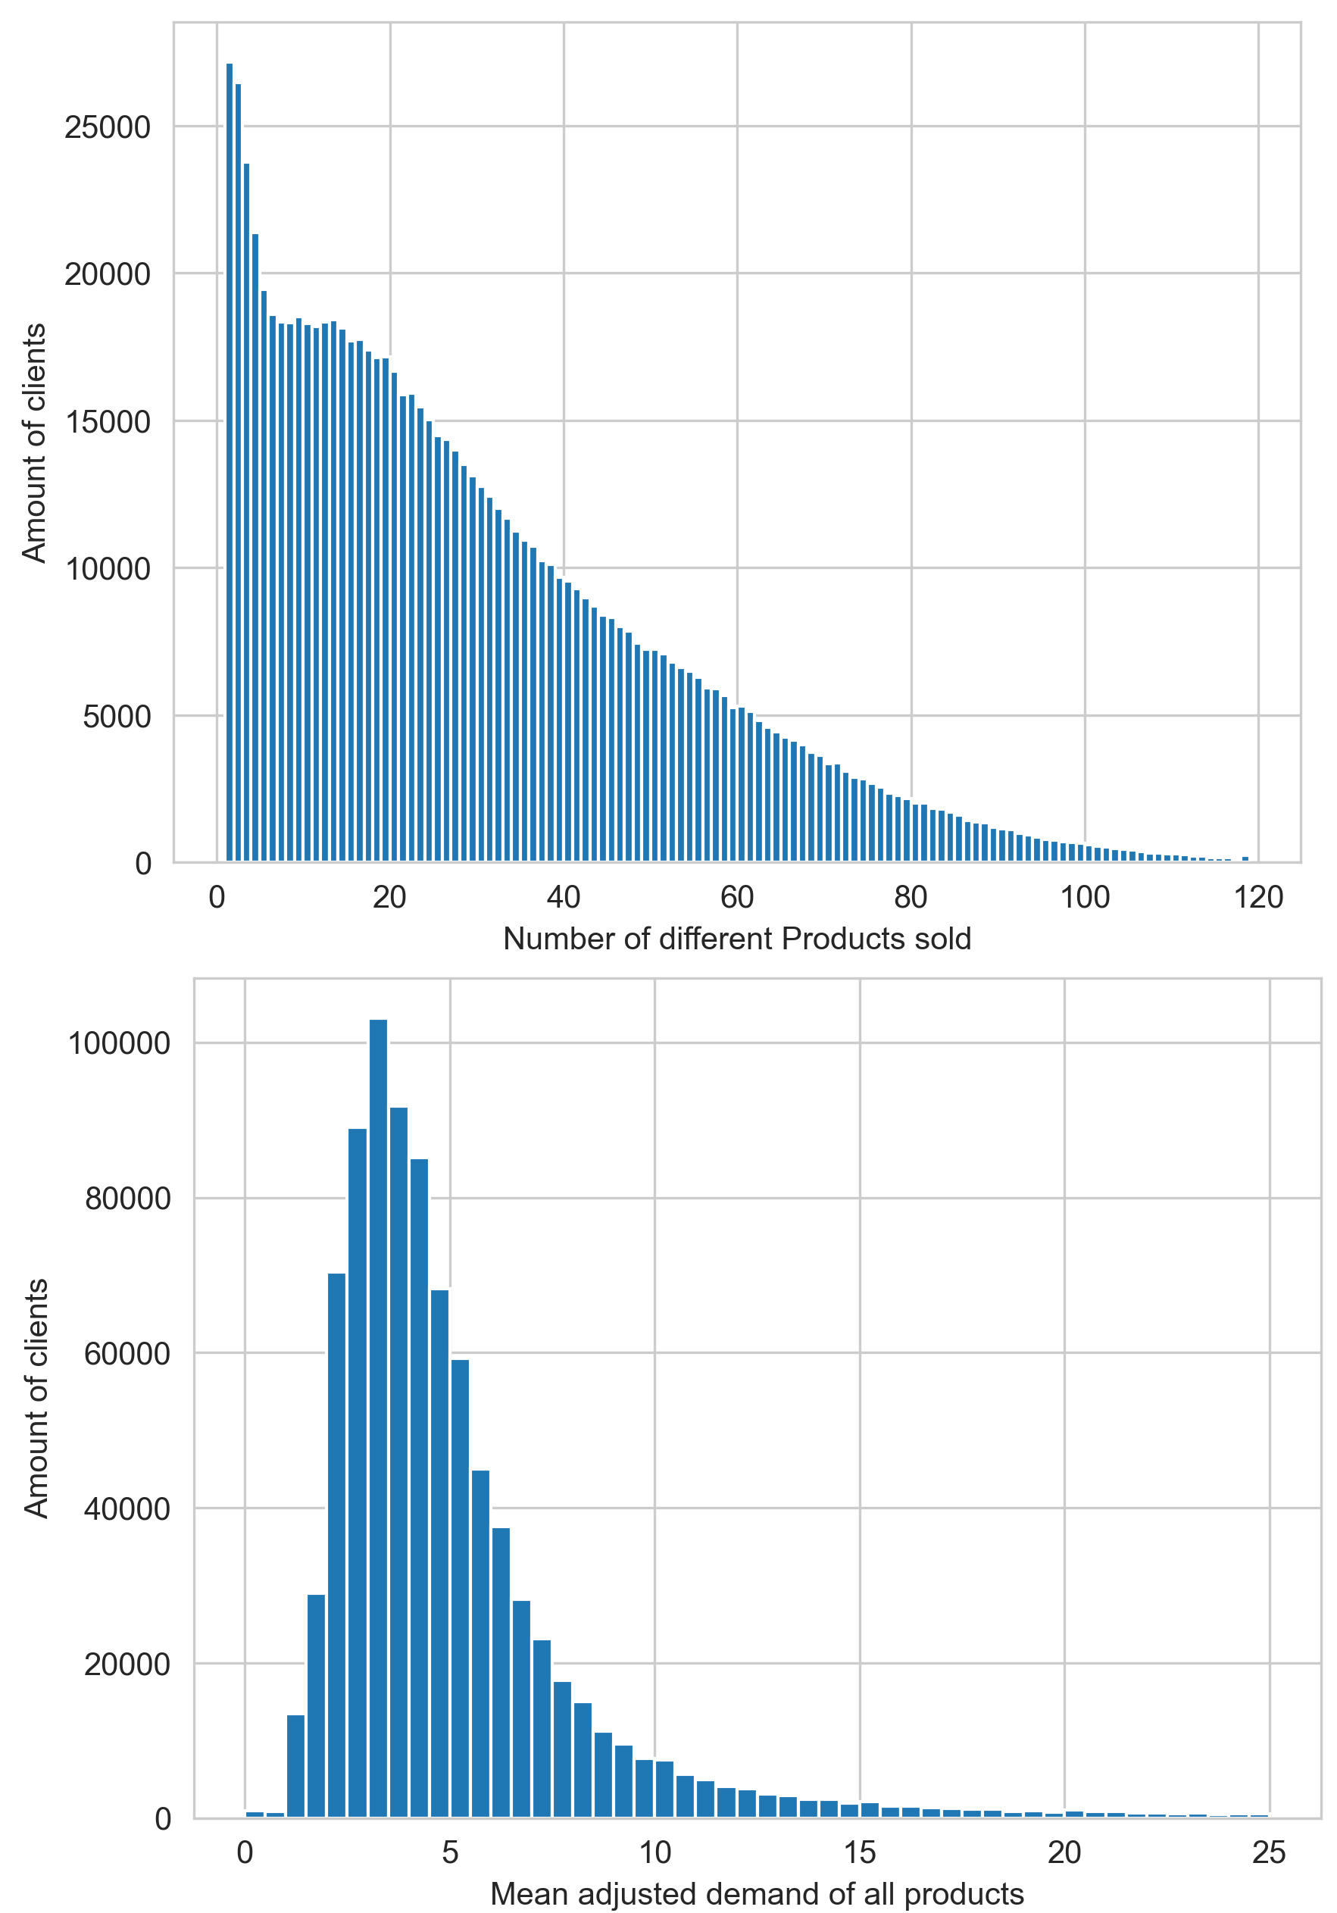
Distribution clients
Notes:
The figure on the left shows the distribution of clients based on their average demand. As you can see, most firms demand less than 10 units per week. The right figure shows the clients' distribution based on the number of unique products they bought. This figure shows that the lion’s share of clients demand various products. Taken together, it seems most clients have demand across a variety of products; however, they demand low quantities of each product.

Slide 7
Challenges
Panel data with only 7 periods
Missing values or no sales?
New clients and new products
Size of data set
Notes:
This is a panel data set with only 7 periods.
As mentioned before, the training data set has roughly 75 million rows! There are around 880k unique clients and 2.5k unique products.
Many client/product pairs have missing values. A common occurrence is ‘client X buys some amount of product Y in weeks 3, 7, and 8’. There is no data for client X and product Y in weeks 4, 5, 6, 9. Did client X not purchase any of product Y during those weeks? Or is this data missing? The answer is not provided.
The clients for which we predict demand in weeks 10 and/or 11 may not be present in weeks 3 through 9. The same issue appears for training models. If we use weeks 3 – 8 observations to train a model, there are new clients in week 9.

Slide 8
What are the predictors?
Previous weeks adjusted demand
Aggregate statistics for each client and product
Client mean sales of all products from weeks 3-9
Product mean sales over all clients from weeks 3-9

Slide 9
Simple model
Client ID | Product ID | Simple model
New | New | 5
New | Old | Product median
Old | New | Client median
Old | Old | Linear regression
Use aggregate statistics to predict demand
Linear regression (i.e. AR(1)) is an improvement
Kaggle score of 0.579

Slide 10
xgboost model
GridSearch cross validation
Features: adjusted demand of the previous 3 weeks, client ID, client mean/median/min/max, product ID, product mean/median
Root mean squared log error of 0.493
Top Kaggle score is 0.442
Notes:
Our best performing model is a gridsearch cross-validated xgboost model. The features are the adjusted demand of the past 3 weeks, client ID/mean/median/min/max, product ID/mean/median.

Slide 11
Future directions
More power!
Imputing missing values
Splitting data into small/big sellers
Models other than xgboost

